Slide 1

Evaluation of 5G Open RAN simulation environments
Research Project
Professor: Dr.-Ing. Andreas Grebe
Student: Md Nur Mohammad
Student ID: 11145131
Master in Communication Systems and Networks

Slide 2
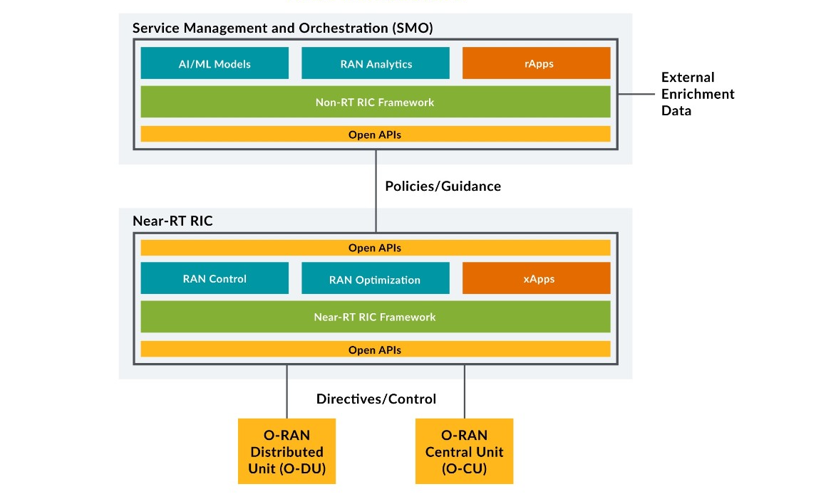

Slide 3
Last Meeting Details
Meeting (20.04.2023)
Build and Check connection between near-RT RIC and non-RT RIC.
Capture packets through Wireshark .
Build policy service.

Slide 4
Last week work
Build Remote Desktop Connection
Build and Check connection between near-RT RIC and non-RT RIC.
Capture packets through Wireshark.

Slide 5
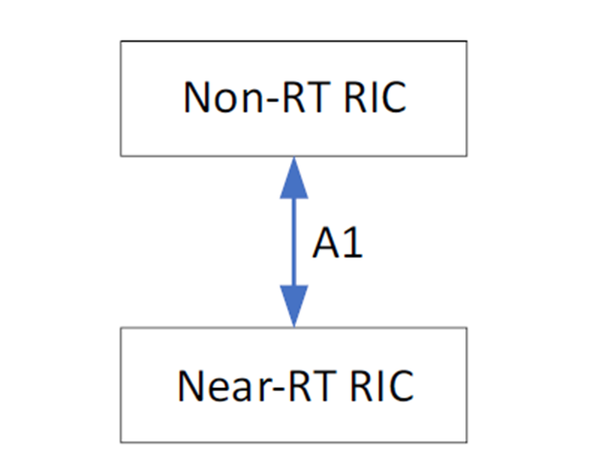
The O-RAN architecture description includes Non-RT RICs and Near-RT RICs connected by the A1 interface as shown in the figure

Slide 6
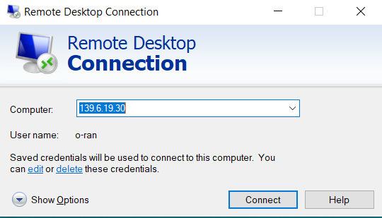
Remote Desktop Connection

Slide 7
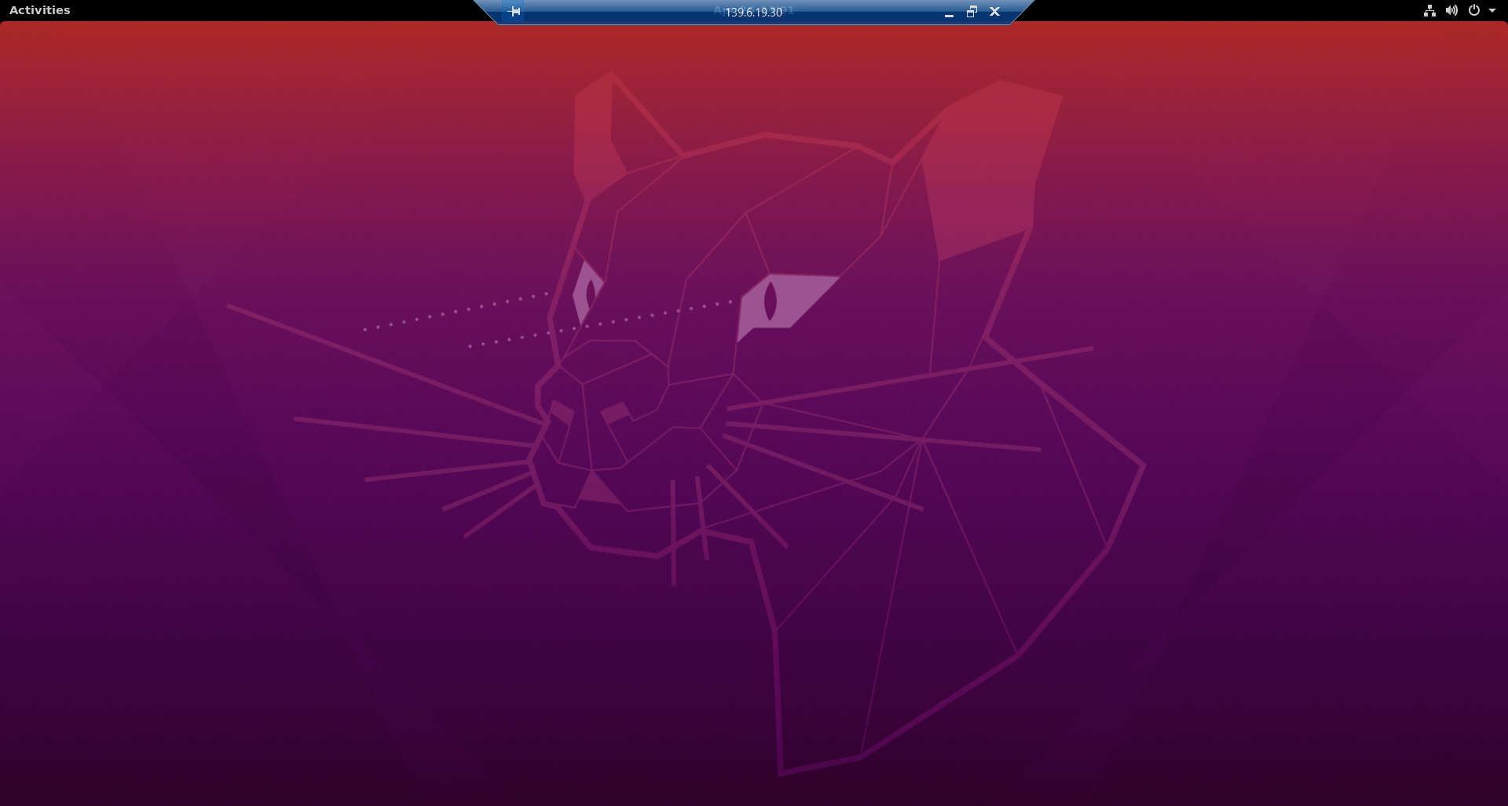
Successfuly Set up Remote Desktop Connection

Slide 8
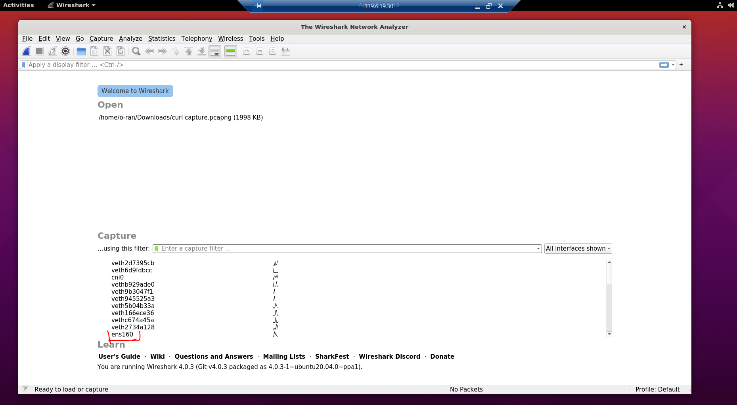
Start Wireshark

Slide 9
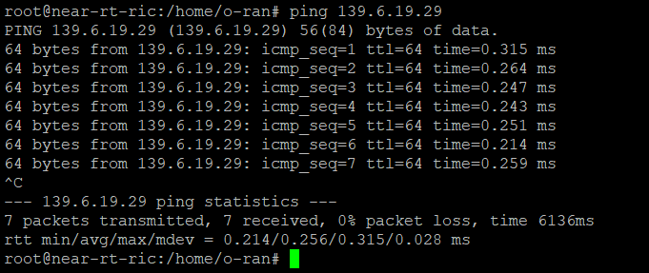
Testing Connection with ping request (near-RT RIC to non-RT RIC)

Slide 10
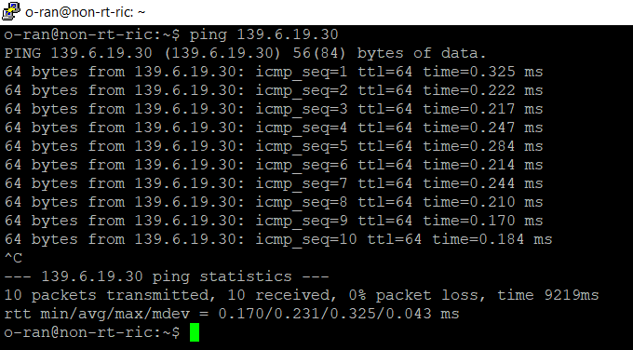
Testing connection with ping request (non-RT RIC to near-RT RIC)

Slide 11
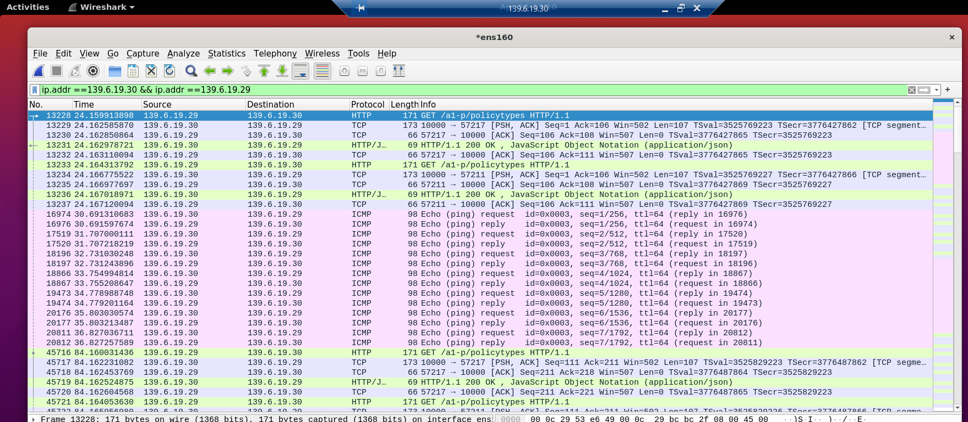
Ping result in Wireshark Capture

Slide 12
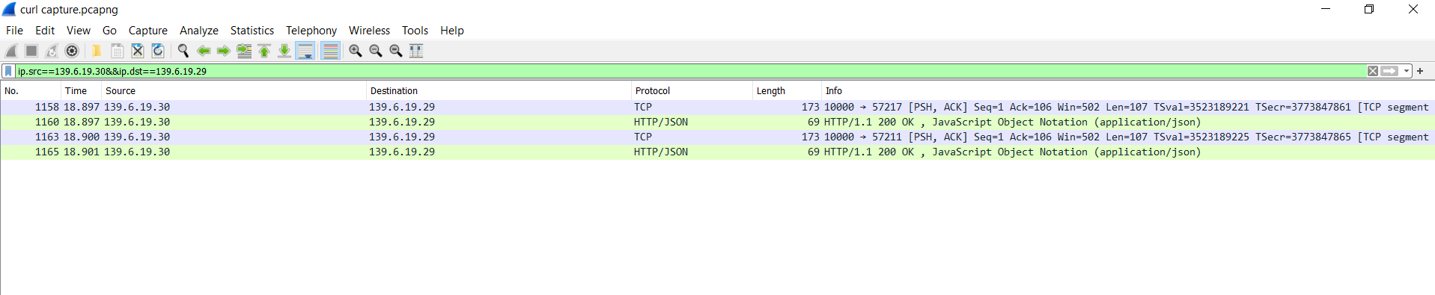
Policy request non-RT RIC to near-RT RIC

Slide 13
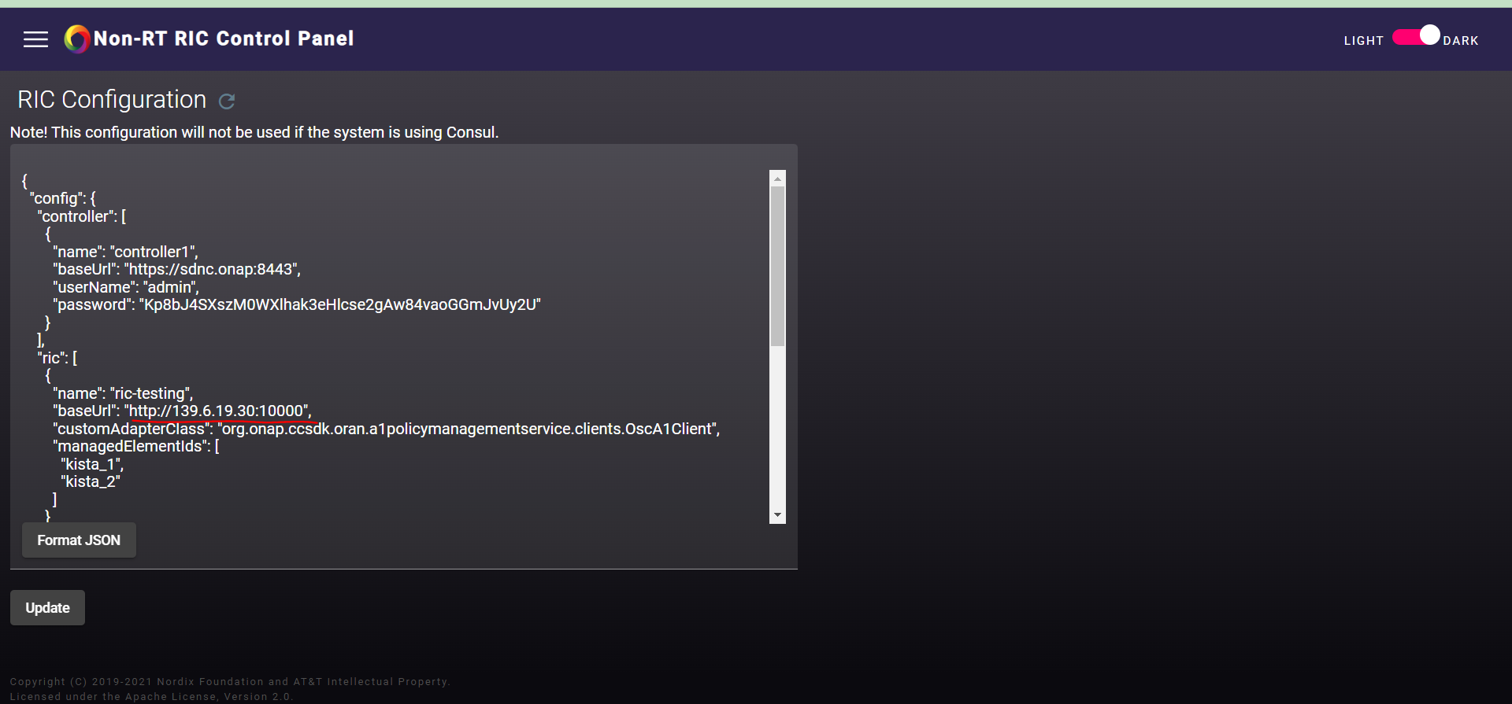
RIC Testing policy

